Slide 1
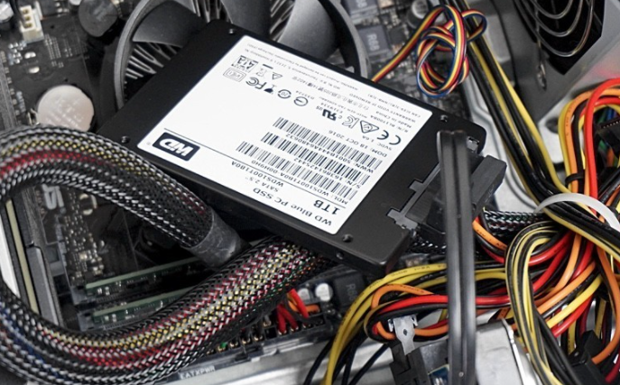
Comparative analysis HDD &SSD

Slide 2
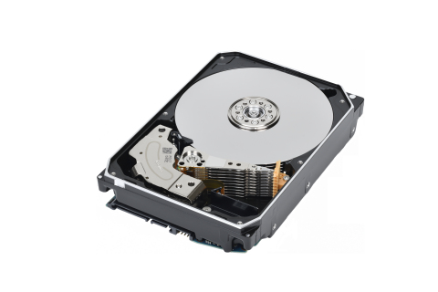
HDD
Computer components to permanently store data
Composed of mechanical parts
They use magnetism to record data and files
Made up of 1 or more rigid disks that rotate high speed
On each plate and its faces a read/write head reads or writes the data
The thinner the disc,better recording
Generally the speed of hard drives is 5400 or 7200 RPM
The price vay depending the size and storage

Slide 3
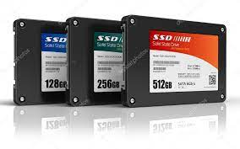
SSD
They are an alternative to hard drives
SSDs store files on microchips with interconected flash memories
They are non-volatile
No physical heads to record data
They have integrated processor to perform reading and writing data
Processors(controlors) make decision about store,retrieve,cache,clean
No rotating component therefore silent.
The size 2.5

Slide 4
Main Diferences HDD vs SSD
 | SSD | HDD
Capacity | In general 256 GB and 4 TB | In general 1 and 10 TB
Consumption | Lower consumption | Higher consumption
Cost | A bit more expensive | Much Cheaper
Noise | Quieter | Noisier
Vibrations | No | Yes
Fragmentation | No | Can be
Durability | Cells can be rewritten in a limited number of times | The mechanical parts can be damaged with movements
Start up time | 7 seconds | 16 seconds
Data transfer | Generally between 200 and 550 MB/s | Generally between 50 and 150 MB/S
Magnetism | No | Magnetism can affect data

Slide 5
Conclusions
It is better combine the both of types hard disk
In a home tower you can use SSD on disk C:to install there the operating system and go faster.
Accompanying it with an HDD as a secondary disk,it is a perfect unit in which to store all the heavy files on the computer

